Slide 1
Async Await and their pitfalls

Slide 2
Agenda
What does the “await” keyword do? How does “await” relate to the current SynchronizationContext?
When at last you “await”?
Where I can’t use “await”?
What happens when I combining "await" and loop. Implementing a simple. ForEachAsync.
What happens when I combining "await" and synchronization primitives.
Why I should prefer Task.Run vs Task.Factory.StartNew

Slide 3
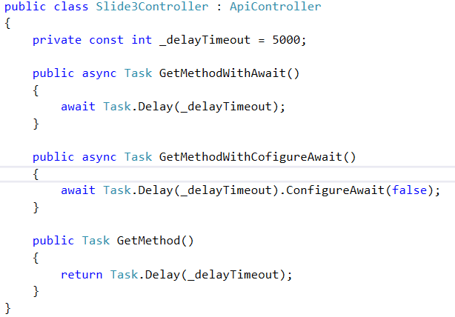
The simplest example of Async Await
Goal:
I want to write the simplest and the fastest implementation of API method.
Questions:
How the methods return task, when they doesn't contain return keyword.
What difference between this method by execution?
How long the methods will execution?
Which method will faster on high load?

Slide 4
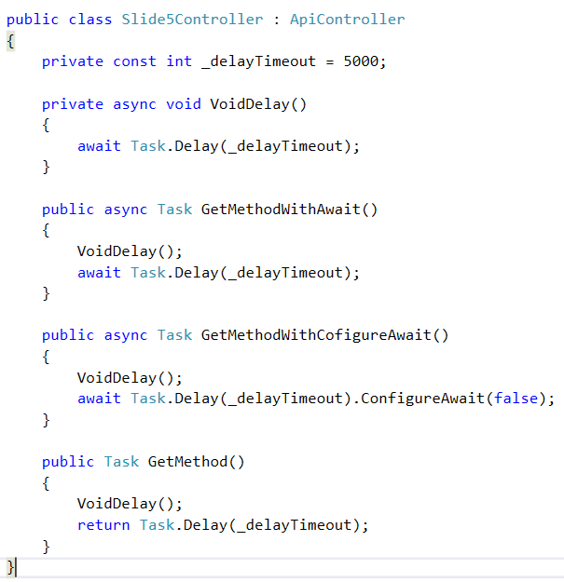
The simplest example with Async void method
Goals:
I want to call the BL method and expect that execution time will increase
Questions:
How long the methods will execution?
Why state machine doesn't wait for the completion of first awaiter
How we should resolve this problem?

Slide 5
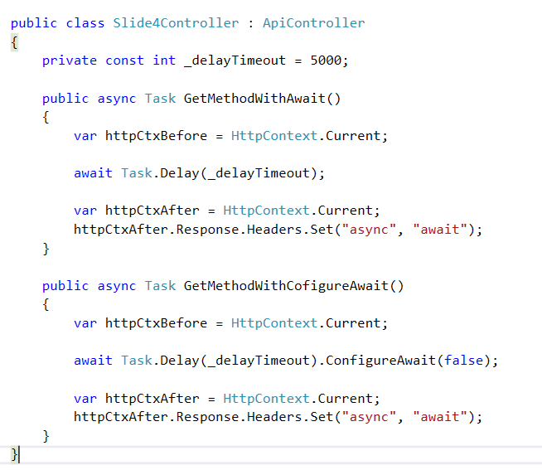
Modification HttpContext & Async Await
Goals:
In this case I want to write custom header in http message
Questions:
What difference between this method by execution?
What problems we will get in those cases?
What does ConfigureAwait(false) do?
How we should resolve this problem?

Slide 6
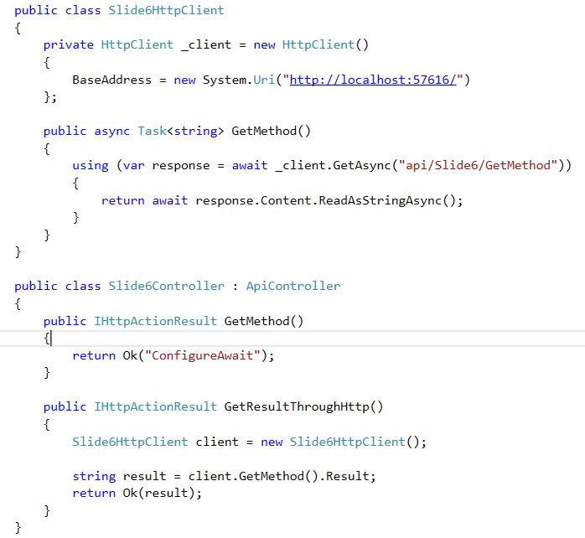
When at last you “await”? (Part 1)
Goals:
I want to mix asynchronous and synchronous methods for better performance
Questions:
What problems does this code contains?
How we should resolve this problem?

Slide 7
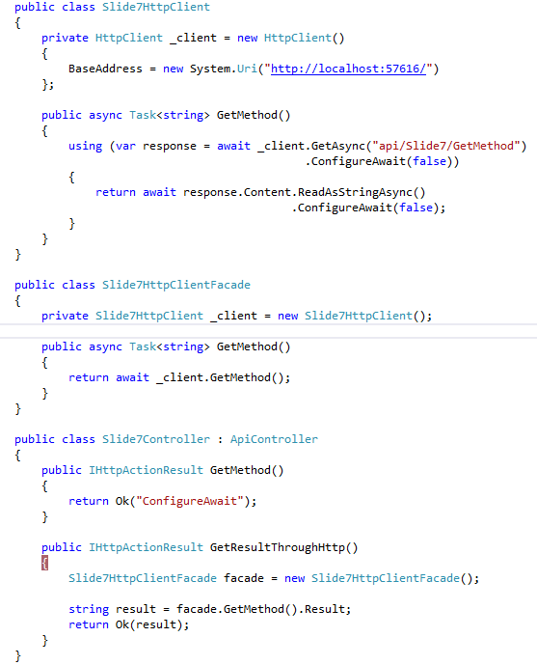
When at last you “await”? (Part 2)
Goals:
I want to mix asynchronous and synchronous methods for better performance
Questions:
What problems does this code contains?
How we should resolve this problem?

